Slide 1
RAID Interface
(Redundant Array of Independent Disks)

Slide 2
Introduction
RAID (redundant array of independent disks) is a way of storing the same data in different places on multiple hard disks or solid-state drives (SSDs) to protect data in the case of a drive failure.
you can choose how to implement RAID on your system. between hardware , software and firmware.
The following list :
Standard RAID levels (0, 1, 2, 3, 4, 5, 6)
Non-standard
Hybrid options (RAID 10)

Slide 3
Working of RAID
RAID Combine multiple hard disks into single logical unit. these are two ways this can be done : in hardware & software.
Hardware combines the drives into logical unit in dedicated hardware which then presents the drives as a single drive to the operating system.
Software does this within the operating system and presents the drives as a single drive to the users of the system.
RAID is typically used on servers but can be used on workstations. This is especially true in storage-intensive computers such as those used for video and audio editing.

Slide 4
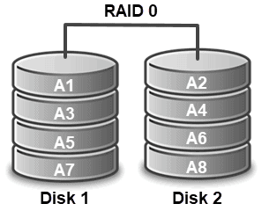
Standards RAID Levels
RAID 0 (striping) :
Divides data into blocks, and then spreads the blocks amongst disks in the array ,Offers NO redundancy ,Any disk failure will corrupt the entire array

Slide 5
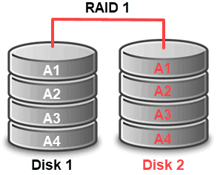
Standards RAID Levels
RAID 1 (mirroring) :
All Data is ‘mirrored’ on duplicate disks , Provides fault tolerance from failure from all but one drive. Least space efficient method Can be fast if implemented correctly

Slide 6
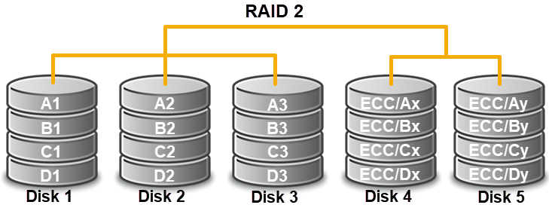
Standards RAID Levels
RAID 2 (Hamming Code ECC) :
Each ‘word’ of data is spread out amongst disks , Error Correction Codes are stored on dedicated ECC disks , Many ECC disks are required, High controller costs. (No commercial implementations have been made)

Slide 7
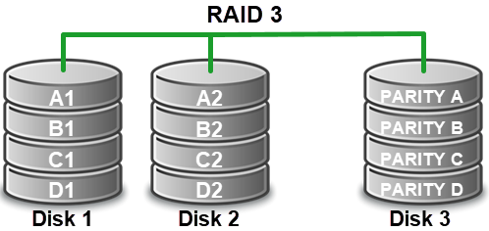
Standards RAID Levels
RAID 3 (Bit level striping with parity) :
Data block is subdivided (striped) and written to data disks. Parity is recorded on a dedicated parity disk .Higher efficiency than RAID 2, yet controllers are expensive .Too resource intensive to be implemented in software .Very high read and write transfer rates.

Slide 8
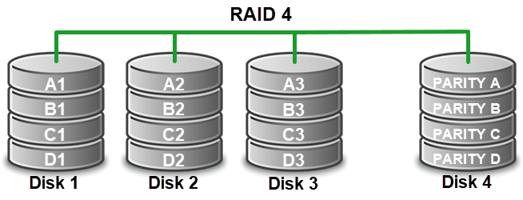
Standards RAID Levels
RAID 4 (Block level striping with parity) :
Identical to RAID 4, but does block-level striping instead of byte-level striping. Again, complex controller design means high cost. Write speed is slower, read speed remains high.

Slide 9
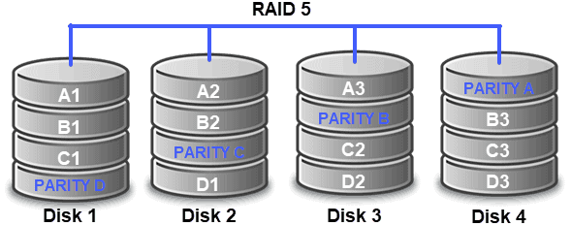
Standards RAID Levels
RAID 5 (Distributed Parity) :
Data blocks written on one data disk, Parity is stored on another disk .Requires a minimum of 3 drives, can tolerate one disk failure. Storage efficiency is equal to the sum of the number of disks in the array, minus one disk. Good transfer rates, highest read rate. Efficient, and a very popular RAID level to use due to it’s low cost and high efficiency

Slide 10
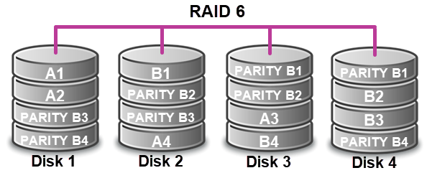
Standards RAID Levels
RAID 6 (Redundant distributed parity) :
RAID 6 extends RAID 5 by using 2 sets of parity blocks – Total storage space is number of drives, minus 2 drives. Can tolerate 2 failures at once .Requires an additional parity calculation.

Slide 11
Nonstandard RAID Levels
RAID 7 ( RAID 3 + 4) :
A nonstandard RAID level based on RAID 3 and RAID 4 that adds caching. It includes a real-time embedded OS as a controller, caching via a high-speed bus.
Adaptive RAID. This level enables the RAID controller to decide how to store the parity on disks. It will choose between RAID 3 and RAID 5.
Linux MD RAID 10. This level, provided by the Linux kernel, supports the creation of nested and nonstandard RAID arrays. Linux software RAID can also support the creation of standard RAID 0, RAID 1, RAID 4, RAID 5 and RAID 6 configurations.
Nonstandard RAID levels vary from standard RAID levels and are usually developed by companies or organizations for mainly proprietary use. Here are some examples.

Slide 12
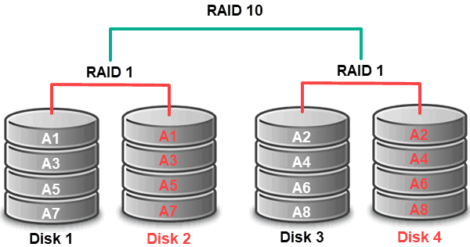
Nested RAID Levels
RAID 10 (Striped Mirrored arrays) :
Stripped array whose segments are RAID 1 arrays. Same overhead & fault tolerance as RAID 1 .High speed .Can sustain certain multiple drive failure.

Slide 13
Advantages of RAID
RAID Improved cost-effectiveness because lower-priced disks
Improve the performance of a single hard drive.
Increased computer speed and reliability after a crash, depending on the configuration.
Reads and writes can be performed faster
Increased availability and resiliency with RAID 5.
With mirroring, two drives can contain the same data, ensuring one will continue to work if the other fails.

Slide 14
Thank you

